Slide 1

Pathogens and hosts, epidemiology
Vincent Jansen
vincent.jansen@rhul.ac.uk

Slide 2
Overview
Epidemiology
Micro- and Macroparasites
SIS model
Basic reproductive number
SIR model
Vaccination
Measles

Slide 3
Parasitism
Parasitoids live a large part of their life on a host and cause considerable harm or death
Parasitism is a lifestyle in which the parasite benefits from its host (+-)
Parasites are smaller than their host
It is like a very small predator, although the interaction need not result in death

Slide 4
Epidemiology:
Is the study of a disease within a population of hosts
Population biology and ecology of pathogens/parasites, vectors and hosts is important for disease control and management
Links processes/parameters at the individual level to population level
Uses mathematical models and statistical techniques

Slide 5
Two groups of parasites:
Microparasites
Have direct and often rapid reproduction within the host
Macroparasites
Do not multiply directly within their host
This difference leads to a convenient dichotomy

Slide 6
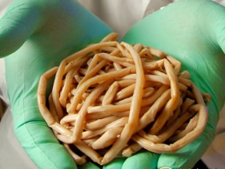
Macroparasites
Do not multiply directly within their host
Are larger and often sexual, e.g parasitic helminths and arthropods
Disease intensity depends on burden
As a consequence:
The individual parasite is a convenient basic unit of study

Slide 7
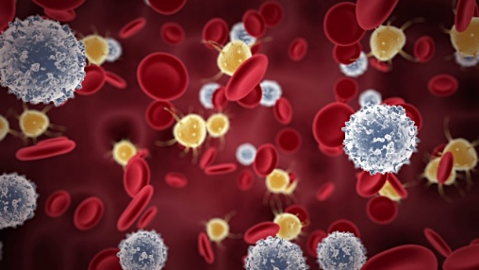
Microparasites
Reproduce directly and rapidly within the host
Are small and often asexual, e.g bacteria, viruses and protozoa
Burden not very relevant/difficult to measure; host is either infected or not
As a consequence:
The host individual is the convenient basic unit of study

Slide 8
Microparasites
I will discuss two standard models (SIS and SIR) to describe the epidemiology of microparasites
This model describes different classes of hosts
And the processes of infection, recovery and mortality (+ births and deaths)

Slide 9
Host classes:
Susceptible hosts can be infected by parasites
Infected hosts carry the parasite
I will assume that all infected hosts transmit the parasite (not doing so leads to a slightly different model which has an extra class)
Infected individuals that recover return to the S class
This is the SIS model
S
I

Slide 10
Transmission process
Susceptible host can become infected
This turns them into infecteds
The rate with which susceptibles encounter infected is given by βSI, where β is the transmission parameter

Slide 11
Recovery process
Infected hosts can recover
If we assume that the rate of recovery is a constant (which is saying that the time until recovery is exponentially distributed), the per capita recovery rate is γ with 1/γ the average time until recovery
We assume that the disease has no lasting effect, and doesnot kill

Slide 12
SIS model
The SIS model reads
This is like the Lotka-Volterra pp model, the Susceptibles act as “prey” for the pathogen. They do not disappear after becoming ill though
In this model so that S+I=N is constant

Slide 13
SIS model
We can thus rewrite the model
S
I

Slide 14
SIS model
In the SIS model you return to a susceptible state after you have had the disease
This is rarely true, but it could be a valid assumption for the common cold, or head lice
The transmission process assumes that if your population is bigger (more S, more I), that there is more transmission
This is often not the case, for instance, much of the transmission of head lice as well as the common cold, takes place in schools or in families
A bigger population does not mean that school classes or families are bigger.

Slide 15
SIS model
As the number of contacts is independent of population size it is often assumed that the transmission is proportional to the fraction of the population that is infected

Slide 16
SIS model
The model then reads
The total population size remains constant, and therefore

Slide 17
SIS model
We can rewrite this as the change in the fraction of the population that is infected:
Does the equation look familiar?
What is the equilibrium?

Slide 18
SIS model
The equilibrium is
The parameter combination β/γ can be interpreted as the transmission rate times the average duration of the infection.
It is the average number of new infections that an infected individual produces in a completely susceptible population.
This is called the basic reproductive number: R₀.

Slide 19
R₀: The basic reproductive number
The number of secondary infections caused by a single infected individual in a completely susceptible population
If R₀<1 the disease will disappear
If R₀>1 an epidemic is possible

Slide 20
SIS model
The equilibrium is
If R₀<1 the disease will disappear
If R₀>1 the disease has a non-trivial equilibrium

Slide 21
More elaborate: the SIR model
Susceptible hosts can be infected by parasites
Infected hosts carry the parasite
I will assume that all infected hosts transmit the parasite (not doing so leads to a SEIR model, E stands for Exposed)
Recovered (immune) hosts do not transmit the parasite and cannot be infected
S
I
R

Slide 22
More elaborate: the SIR model
In its simplest form the SIR model takes the form
S
I
R

Slide 23
Solution: an epidemic
S
R
Fraction of population
I
Note: the disease disappears in this case
Time (years)

Slide 24
Effect of decreasing the transmission rate
Infecteds as fraction of population
Time (years)

Slide 25
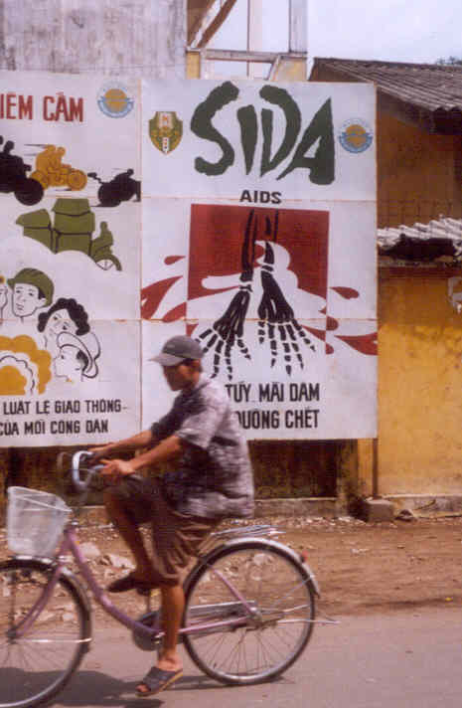
Campaign against AIDS in Vietnam

Slide 26
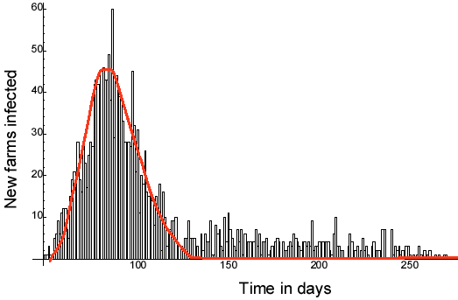
Outbreak of Foot and Mouth Disease in 2001

Slide 27
A more elaborate SIR model
The model can easily be extended
For instance, if we add natural death (with rate μ) and disease induced mortality, ν, we get (if we replace all dead by newborns)
μN+vI
βIS/N
γI
S
I
R
μS
(μ+ν)Ι
μR

Slide 28
More elaborate: the SIR model
The model reads:
μN+vI
βIS/N
γI
S
I
R
μS
(μ+ν)Ι
μR

Slide 29
Now susceptibles are born into the population the disease can become endemic
R
Fraction of population
S
I
Time (years)

Slide 30
If new susceptibles are born into the population the disease can become endemic
Note the oscillatory behaviour. This is similar to the behaviour of prey-predator models
This is caused by the slow build up of susceptibles, that then get immunised in an epidemic

Slide 31
SIR model
When is an epidemic possible?
This is asking if the disease-free equilibrium S=N, I=0, R=0 is unstable.

Slide 32
SIR model
When is an epidemic possible?
This turns out to be R₀ >1

Slide 33
R₀ for the SIR model
Note: formula not very practical in many cases.
Nr of susceptibles infected per unit of time
Average duration of infection
R₀ =
1
βS₀/N
βS₀/N
x
=
μ+v+γ
μ+v+γ
S₀=The number of susceptibles in population without disease
γI
I
(μ+ν)Ι

Slide 34
R₀: The basic reproductive number
If the reproductive number < 1 the nr of infecteds decreases
If the reproductive number > 1 the nr of infecteds increases, possibly leading to epidemic

Slide 35
To control and eradicate a disease R₀ has to be reduced below 1
R₀
βS₀/N
=
μ+v+γ
How to control a disease:
Reduce transmission (β)
Reduce the duration of the infections (γ, ν)
Reduce the fraction of susceptibles (S₀/N)

Slide 36
Reduce Transmission
Reduce vector population (malaria, dengue)
Stop movement (Ebola)
Use of mosquito nets (malaria)
Use of condoms (STDs)
Isolate infected hosts (tuberculosis, plague, SARS, Ebola)

Slide 37
Reduce duration of infection
Treatment with antibiotics (bacterial infections) or antivirals
Treatment of malaria
But some treatments can prolong infectious period, e.g. suppression of fever

Slide 38
Increase disease induced mortality
Not a realistic option for human population
Can be applied to animal diseases:
Culling (FMD, swine fever)

Slide 39
Decrease number of susceptibles
Vaccination
births (1-p)
births (p)
βIS/N
γI
S
I
R
V
μS
μR
μV

Slide 40
Other models
Can be easily constructed using these building blocks
Some examples:
Vertical Transmission
Vaccination
births
births
births
βIS/N
γI
S
I
R
V
μS
(μ+ν)I
μR
μV

Slide 41
Vaccination
If a fraction p is vaccinated, a fraction 1-p is susceptible
The basic reproductive number in a vaccinated population is:
R_{0p}
β(1-p)S₀/N
=(1-p)R₀
=
μ+v+γ
The fraction that needs to be vaccinated to eradicate the disease is:
p_{c}=1-1/R₀

Slide 42
exercise
The calculation of the basic reproductive number

Slide 43
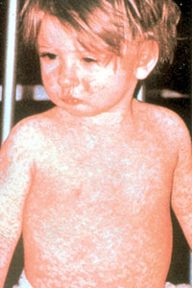
Measles
Symptoms include coughing, runny nose, stuffy nose, malaise, red eyes, tearing and fever.
Two to four days after these initial symptoms, blue-white spots with a red background (Koplik's spots), located on the inside of the cheeks near the back molars start to appear.
They are accompanied, either at the same time or slightly later, by the appearance of the measles rash.

Slide 44
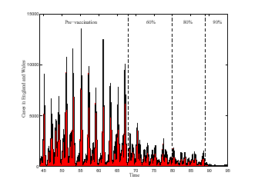
Measles in England and Wales (1945-1995)
Cases in England and Wales
Time (years)
Source: M. Keeling

Slide 45
A model for measles
We can use the SIR model to describe measles
We will assume a constant population size: on the time scale of interest population growth is limited
We will assume a fixed nr of contacts hence the transmission is βIS/N
We will assume that there is no disease caused mortality, i.e. ν=0

Slide 46
A model for measles
the SIR model:
S+I+R=N

Slide 47
A model for measles
The parameters:
Let’s say the average life time is 75 years, hence the mortality rate μ=1/75 [yr]⁻¹
The duration of the infectious period is about one week, hence γ=50 [yr]⁻¹
There are about 3 infectious contacts per day, hence β=1000 [yr]⁻¹ [individual]⁻¹
The R₀ in this model is β/(μ+γ)
R₀ is then about 20.
R₀ has been estimated to be between 15 and 25

Slide 48
A model for measles
the equilibria of the model

Slide 49
A model for measles
the equilibria of the model

Slide 50
A model for measles
On the basis of these parameters you can work out what the average age of contraction measles is, if the disease is endemic
The force of infection at equilibrium is βI*/N
The average time until infection is
This is the average lifetime divided by R₀-1
This is about 4-5 years of age
Measles is a childhood disease because the R₀ is high, not because it cannot infect adults

Slide 51
exercise
Investigate the dynamics of the SIR model

Slide 52
A model for measles
Solutions:

Slide 53
Measles in England and Wales (1945-1995)
Cases in England and Wales
Time (years)
Source: M. Keeling

Slide 54
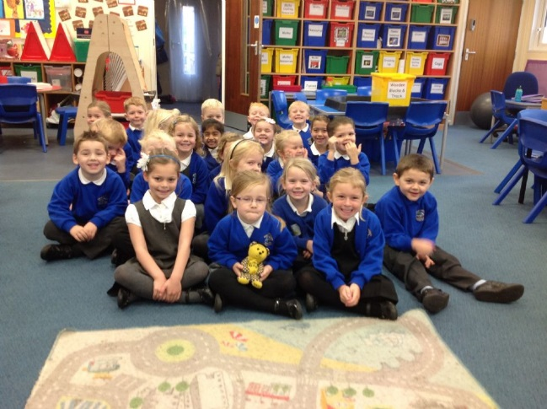
Variation in transmission
Measles incidence peaks every second year
It has been suggested that this is because the transmission is not constant but varies over the season (school terms)
We can include this in the model by changing β with time, so that it changes periodically

Slide 55
A model for measles
the SIR model:
But now
time

Slide 56
exercise
Investigate the periodically forced SIR model
The bifurcation diagram worked on some machines, not on others. Do a screen shot of the final result as a back up.
Need to spread the exercise out. First, look at dynamics, then bif diagram
To visualize the dynamics: show beta(t) and I(t) for both one and two period cycles.

Slide 57
If variation in transmission included in the model:
Result:

Slide 58
Variation in transmission
This lends support to the suggestion that the periodicity is caused because of the seasonal forcing of the transmission rate

Slide 59
Seasonal variation in transmission
Earn et al. (2000) studied a SEIR (susceptible-exposed-infected-recovered) model with seasonal forcing
They produced the following figure

Slide 60
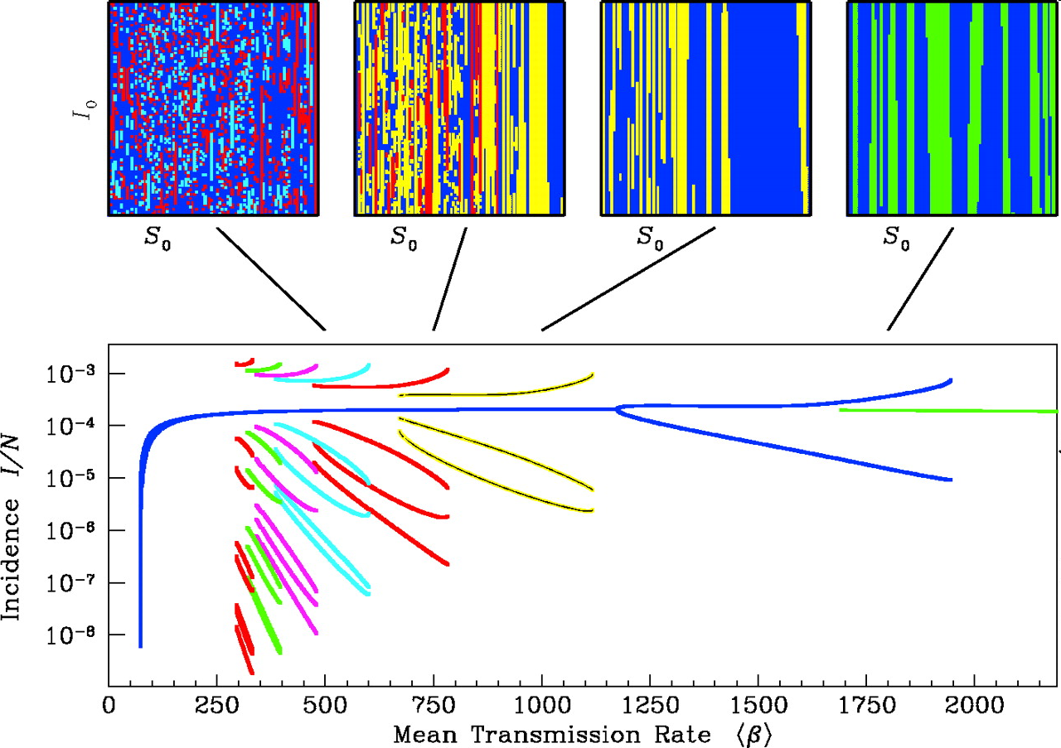
What is going on here?
Notes:
The main panel is the bifurcation diagram for the term-time forced SEIR model, showing incidence on 1 January, normalized by (constant) population size; the control parameter is the mean transmission rate 〈β〉. The fixed parameter values are γ−1 = 5 days, σ−1 = 8 days, μ = ν/N = 0.02 year−1, seasonal amplitude 0.25 [see (5) and (13) for the meaning of these parameters]. Each attractor is identified with a different color. For sufficiently high 〈β〉, there is a unique (annual) attractor. As 〈β〉 is reduced, biennial, 3-, 4-, 5-, 6-, 7-, and 8-year cycles all occur, before all but the annual attractor are extinguished. The term-time forcing function used to produce this figure corresponds to school terms in England and Wales. In the United States, the summer holiday is longer; this does not affect the structure of the bifurcation diagram, but with a longer summer holiday each of the various bifurcations occurs at lower 〈β〉 (10). Above the bifurcation diagram, basins of attraction (initial susceptibles, 0 < S0/N < 0.1, versus initial infectives, 0 < I0/N < 0.0001, with E0/N = 0.0001) are shown for the various attractors at four particular values of 〈β〉. Figure 2 identifies regions of this diagram that correspond to the dynamics observed at various times and places.

Slide 61
Seasonal variation in transmission
This is caused by resonance
The is a general phenomenon in forced systems where the original system has its own amplitude
“Arnold tongues”

Slide 62
Seasonal variation in transmission
This is caused by resonance
The is a general phenomenon in forced systems where the original system has its own amplitude
“Arnold tongues”

Slide 63
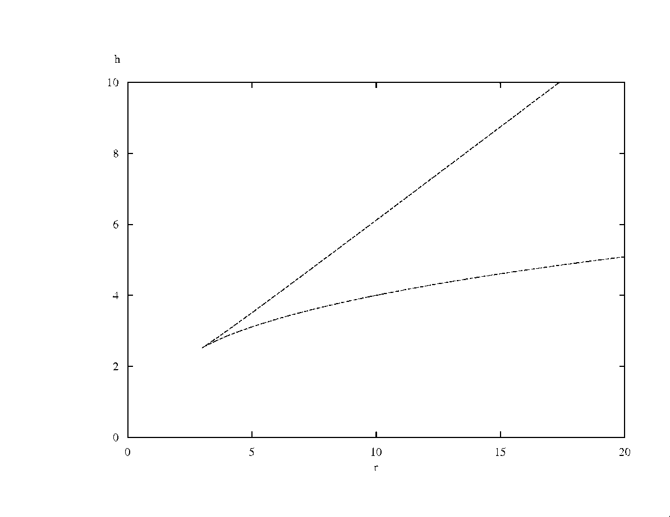
Seasonal variation in transmission: resonance of an undamped oscillator
α
Amplitude of forcing
At this point the unforced system has a period, which is a multiple of the forcing period

Slide 64
Seasonal variation in transmission: resonance of a damped oscillator
α
Amplitude of forcing
At this point the unforced system has a period, which is a multiple of the forcing period

Slide 65
Variation in transmission rates
The period of the unforced system follows from the eigenvalue.
If the system has a complex eigenvalue of λ=v+iw, the linearised dynamics are of the form:
The frequency of the dynamics is therefore w and the period 2π/w

Slide 66
Variation in tranmission rates
To find the period of the unforced system we need the imaginary part of the eigenvalues at equilibrium

Slide 67
Variation in transmission rates
To find the period of the unforced system we need the imaginary part of the eigenvalues at equilibrium
One eigenvalue is -μ
The other two come from the matrix

Slide 68
Variation in transmission rates
To find the period of the unforced system we need the imaginary part of the eigenvalues at equilibrium
Has eigenvalues with approximate imaginary part

Slide 70
Variation in transmission rates
We can now find the period ( ) and predict the position of the Arnold tongues from
6
5
4
3
2
791
379
235

Slide 71
some Arnold tongues
amp
Period 5
Period 4
Period 3
Period 2
b

Slide 72
Effects of seasonal variation
The dynamics of a seasonally forced epidemic strongly depend on the R0 (approx β/γ)
High R0: annual or biannual cycles.
Low R0: outbreaks followed by years of absence, e.g influenza
For low R0 the densities can reach very low numbers, and lead to “fade out”
Therefore the disease can disappear, even if the R0>1

Slide 73
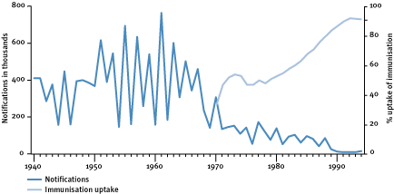
Vaccination
In the last years measles has as good as disappeared because of vaccination

Slide 74
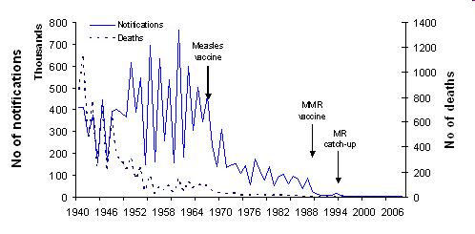
Vaccination
In the last years measles has as good as disappeared because of vaccination

Slide 75
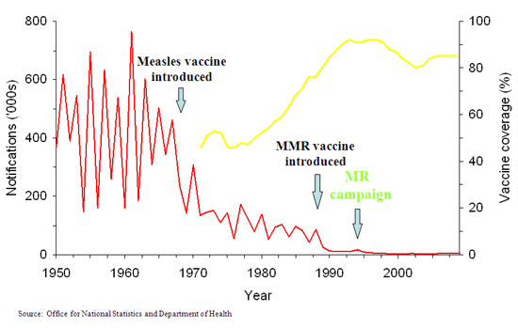
Vaccination
In the last years measles has as good as disappeared because of vaccination

Slide 76
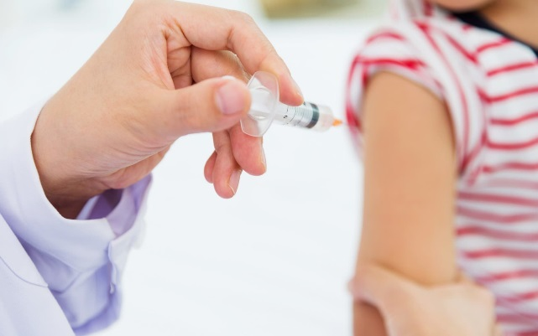
Vaccination
Vaccination worked because the vaccination rate was high enough to stop the disease being endemic
But even in the years when incidence was very low, measles still occasionally appeared following importations in the population

Slide 77
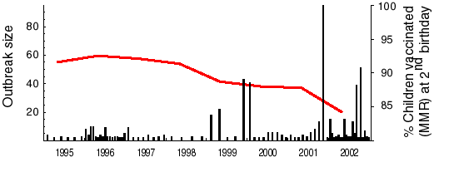
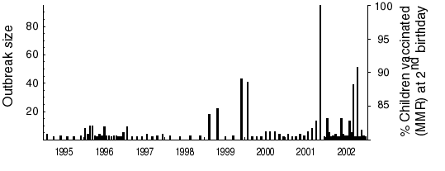
Measles outbreaks in England and Wales in 1995-2002

Slide 78
Vaccination
After 1999 vaccination levels decreased due to (unfounded) claims that MMR could lead to autism.
This has led to large outbreaks and an increase in the reproductive number

Slide 79
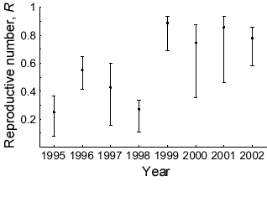
Reproductive number after vaccination R₀(1-p)
From: Jansen et al. Science, 301, 804 (2003)

Slide 80
Vaccination
Based on the same principles as the deterministic SIR model, a stochastic model can be formulated
A stochastic model describes the chance processes

Slide 81
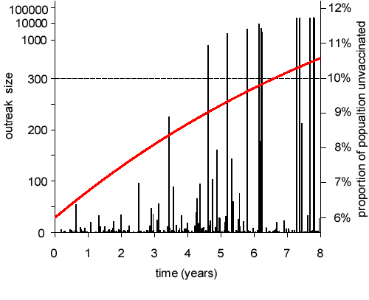
Outbreak size depends on R₀
Number of cases
1.0
R₀ = β/γ times fraction not vaccinated

Slide 82
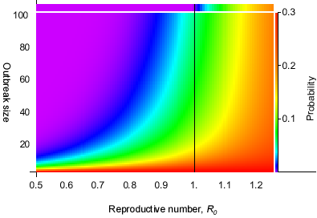
Probability of getting a outbreak of certain size or larger

Slide 83
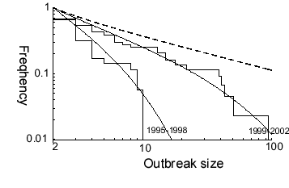
Outbreak distribution shows progression toward R₀=1
R₀=1

Slide 84
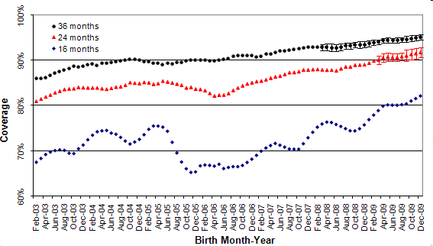
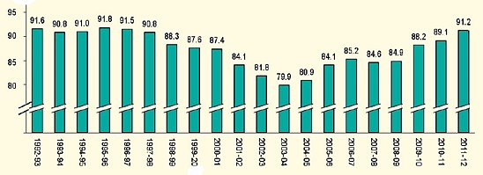
Vaccine uptake at 2nd birthday
Notes:
MMR sentinel surveillance scheme coverage in England
Data collected from March to May 2011 for children in the four age cohorts are summarised in table 5. Data ranged from 80.8 to 83.1% at 16 months, 87.7 to 88.2% at 20 months, 89.8 to 91.1% at 24 months, and 92.9 to 93.2% at 36 months.
Table 5. Monthly sentinel estimates of measles, mumps rubella (MMR) coverage at 16, 20, 24 and 36 months: March to April 2011 Evaluation month Proportion of children vaccinated at each age Number of PCT/trusts 16 months 20 months 24 months 36 months March 201135 80.8 88.2 89.8 93.1 April 201135 82.2 87.8 91.1 93.2 May 201133 83.1 87.7 90.8 92.9 The figure (below) shows observed and projected MMR coverage at 16, 24 and 36 months in England for birth cohorts from February 2003 to December 2009. Projections of coverage at 24 and 36 months were made using the most recent coverage data for the same birth cohort and an estimate of the proportion, p, of those unvaccinated at each earlier age who were subsequently vaccinated by the later age. The proportion was estimated using the most recent 18 months data where final coverage was known. 95% confidence intervals were calculated based on the variability of p in the past data. The estimates of p were as follows: 54.2% for 16 to 24 months, 72.6% for 16 to 36 months, 23.7% for 20 to 24 months, 54.6% for 20 to 36 months and 40.2% for 24 to 36 months. Projections make the assumption that p remains constant over the period of the projection. Data at 20 months is not shown to simplify the graph as the line is close to that plotted for the 24 month data.

Slide 85
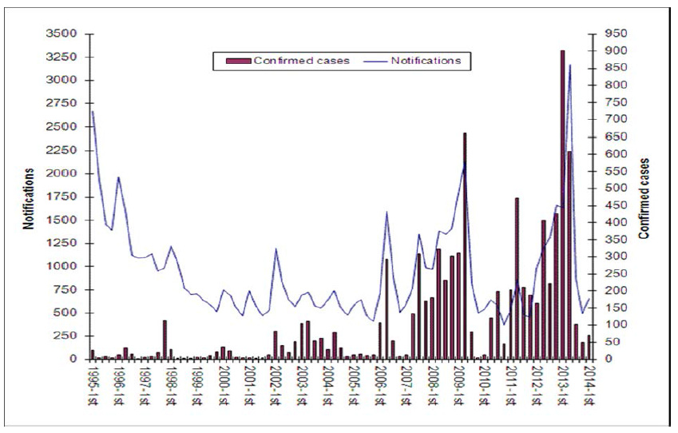
Measles cases since 1995

Slide 86
Nr of cases of 1996-2016
 | Measles | Mumps | Rubella
1996 | 112 | 94 | 2770
1997 | 177 | 180 | 99
1998 | 56 | 119 | 119
1999 | 92 | 372 | 162
2000 | 100 | 703 | 60
2001 | 70 | 777 | 43
2002 | 308 | 502 | 65
2003 | 438 | 1556 | 17
2004 | 191 | 8130 | 14
2005 | 77 | 43322 | 28
2006 | 740 | 4426 | 32
2007 | 990 | 1476 | 35
2008 | 1370 | 2405 | 27
2009 | 1144 | 7662 | 9
2010 | 380 | 3965 | 12
2011 | 1086 | 2465 | 6
2012 | 2030 | 2564 | 65
2013 | 1843 | 4035 | 12
2014 | 121 | 2604 | 3
2015 | 91 | 718 | 5
2016 | 547 | 571 | 2
Notes:
The 2005 mumps epidemic mainly affected the cohorts born between 1983-1987 (18-22 yr olds). 2013 had a catchup programme
https://www.gov.uk/government/news/measles-figures-down-following-successful-catch-up-programme

Slide 87
Catch-up campaign
In the first 3 months of 2013 there was an increase in number of cases of measles, which was most marked among 10 to 16 year-olds. A national catch-up campaign was launched to ensure that 95% of children aged 10 to 16 years received at least one dose of MMR vaccine by 30 September 2013.

Slide 88
Still ongoing
The presence of an unvaccinated cohort in the population is still very visible in the measles incidence and for years we saw substantial measles outbreaks
Following the 2013 catch-up campaign the vaccine coverage appears to be back to a safer level.
All these efforts are possible because we can calculate the critical level of vaccination and estimate the reproductive number.
Notes:
Could consider including the New Zealand case

Slide 89
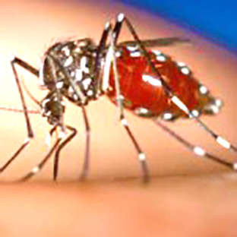
Zika virus
The Zika virus is a flavivirus
It is mainly transmitted by mosquitos
first discovered in the Zika forest in Uganda in 1947
Aedes aegypti taking
a blood meal

Slide 90
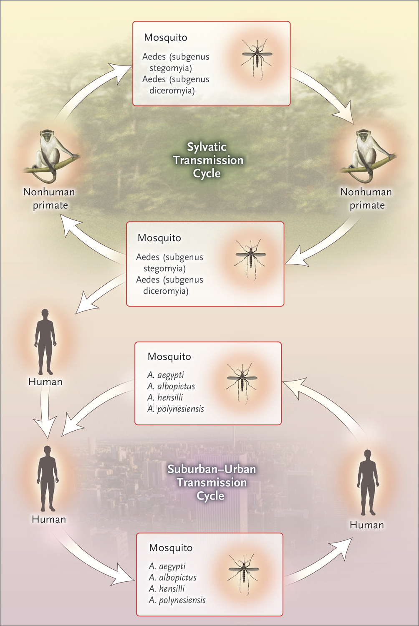
Zika virus
In Uganda the primary hosts are monkeys
In urban/semi urban environments human to human transmission possible through Aedes aegypti and Aedes albopictus
First found in humans in 1953

Slide 91
Zika virus
Symptoms: fever, rashes, muscle pain, malaise. Symptoms generally mild and last for 2-7 days.
Often infection is asymptomatic, and the disease was considered of little importance prior to 2007

Slide 92

Zika virus
From 2007: outbreaks in various Pacific islands, and a rise in complications from the virus: Guillain-Barré syndrome
2015: starts to appear in Asia (few cases) and South America, notably Colombia and Brazil. Brazil notes rise in microcephaly cases

Slide 93
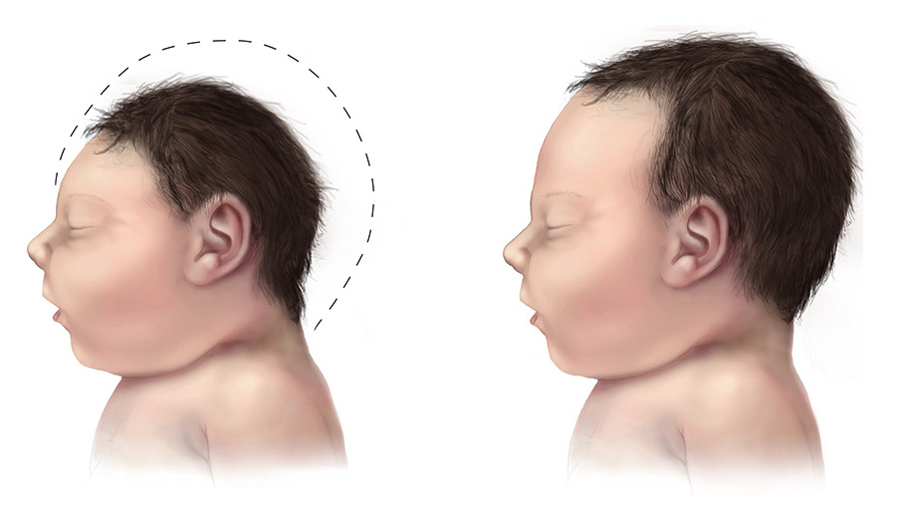
Microcephaly is when a baby’s head doesn’t develop to its full size. It can be a complication of Zika virus if women are infected during pregnancy. Microcephaly reduces life expectancy and brain function is affected. The condition cannot be treated.

Slide 94
Zika virus
Latency period: not known, thought to be 2-7 days
Transmission route: Aedes mosquitoes thought to be the main route, some evidence for sexual and mother-to-child transmission
How many people have Zika? Not known (remember the disease is often asymptomatic). 70 countries have reported outbreaks. An estimate give up to 4 million 2016 in the Americas
Basic reproductive number: various papers give ranges from 2-10.

Slide 95
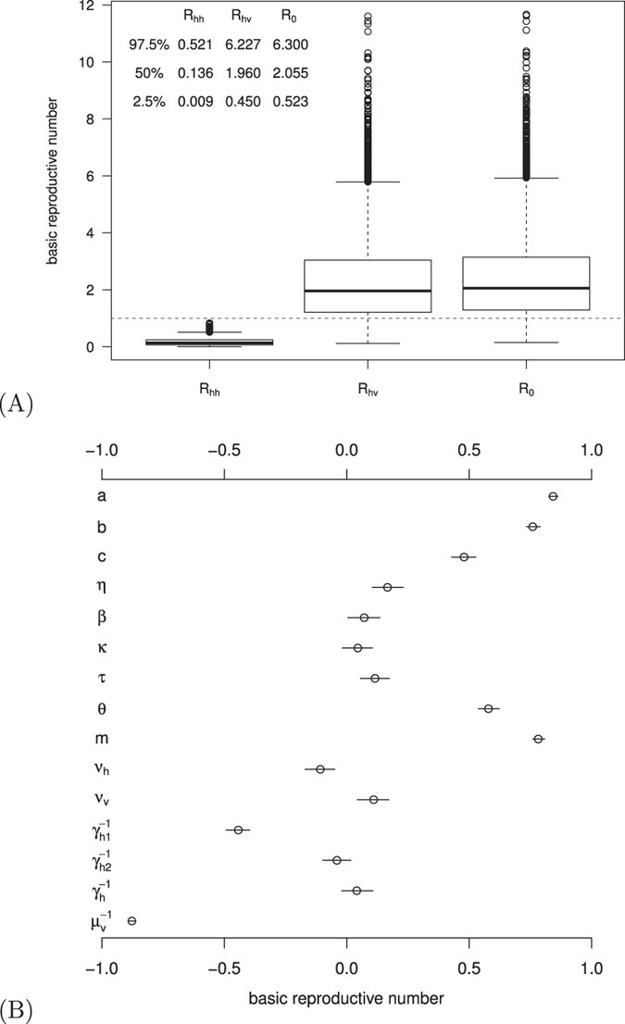
Estimates for the R0 for the sexual, mosquito route, and the combined R0 in Colombia
Gao et al. (2016) Scientific reports.
Doi:10.1038/srep/28070

Slide 96
Zika virus
Why is a disease that before was of no importance now a major concern?
What causes the over 1500 microcephaly cases in Brazil? Is it Zika? Why don’t we see it in other countries?
Can Zika be controlled?

Slide 97
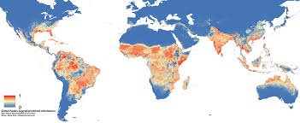
Why is a disease that before was of no importance now a major concern?
Aedes distribution

Slide 98
Why is a disease that before was of no importance now a major concern?
It is not a surprise that a disease that previously occasionally spread from a wildlife reservoir spreads like wildfire once it is introduced in a semi-urban environment with abundant vectors, and an R0 well above 1
A particular worry:

Slide 99
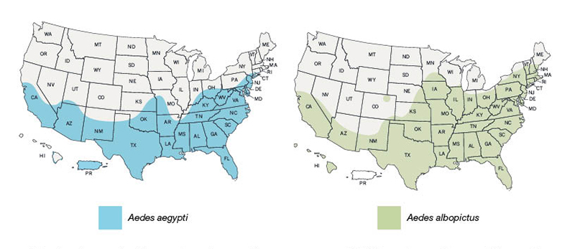
Why is a disease that before was of no importance now a major concern?
Estimated range of Aedes aegypti and Aedes albopictus in US

Slide 100
What causes the, over 1500, microcephaly cases in Brazil? Is it Zika? Why don’t we see it in other countries?
There is a lot we don’t know
We don’t know what the baseline of microcephaly is in Brazil, and we don’t know for sure that these are caused by Zika.
We do know that there is an association between Zika and microcephaly: a small sample showed that in a group of pregnant women with Zika, 29% had fetal abnormalities
The lower numbers in other countries appear partially caused by underreporting*.
* DOI: 10.1126/science.aal0498

Slide 101
Could there be an association with Dengue?
Dengue fever is caused by a similar flavivirus, and causes similar symptoms
After the first infection lifelong immunity develops against the type of Dengue that caused the infection
……… but there are 5 serotypes, and if you get infected by a different type the virus is enhanced by the immunity against the previous infection (Antibody-Dependent Enhancement) and the disease can be much more severe.

Slide 102
Could there be an association with Dengue?
Recently several papers* reported antibody dependent enhancement between Dengue and Zika
Previous exposure to Dengue could then enhance the effect of Zika, causing it to replicate faster and increase the risk of complications
* e.g.: Dejnirattisai et al. (2016) Nature Immunology, doi:10.1038/ni.3515

Slide 103
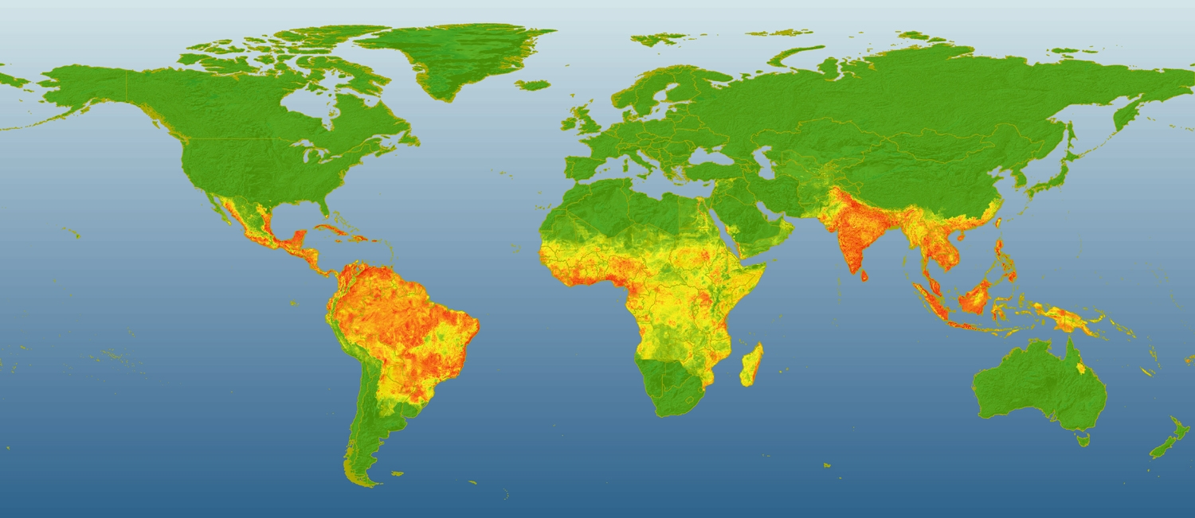
Global distribution of dengue

Slide 104
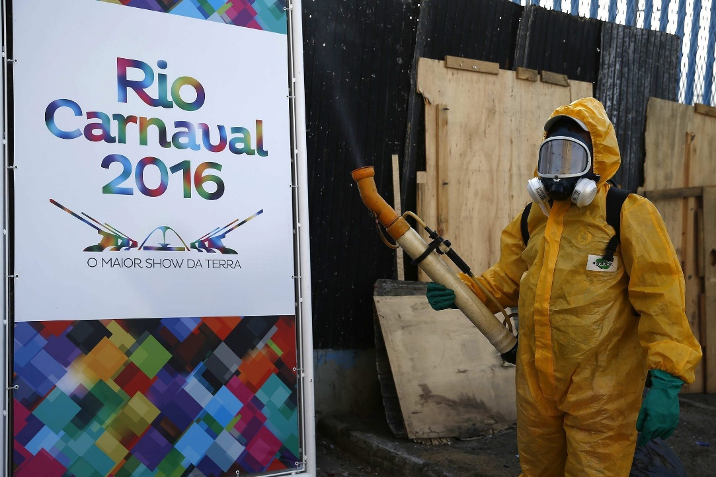
Can Zika be controlled?
We have a disease with an R0 of 2 or more
There is a large vector population which has not been controlled for a while
There is no vaccine as yet (there are trials)

Slide 105
Can Zika be controlled?
MIAMI — The director of the Centers for Disease Control and Prevention delivered a grim assessment Tuesday of the government's ability to contain Zika, saying it's too late to stop the dangerous virus from spreading throughout the United States.
"Zika and other diseases spread by (the Aedes aegypti mosquito) are really not controllable with current technologies," CDC Director Thomas Frieden said. "We will see this become endemic in the hemisphere."
USA TODAY, October 25, 2016

Slide 106
Zika control and management
There are efforts to control the vector population with sterile male techniques or Wolbachia under way
But will it work?
(see: http://www.who.int/emergencies/zika-virus/articles/mosquito-control/en/)

Slide 107
What about Microcephaly?
A vaccine would allow protection of pregnant women, there still are challenges though*
Will the number of microcephaly cases fall naturally?
* Marston, H.D., et al. N Engl J Med 2016; 375:1209-1212

Slide 108
What about Microcephaly?
Zika infection probably leads to immunity*.
Someone suggested: “As more and more people acquire immunity to Zika, its spread will be limited to those who have never been exposed. Given enough time, new infections will be limited to the young. As long as infections occur prior to child-bearing years, microcephaly in newborns should not be a concern. ”**
The nr of infected fluctuates before the
disease becomes endemic
*Dudley DM, et al. A rhesus macaque model of Asian-lineage Zika virus infection. Nat Commun 2016;7:12204-12204
** http://theconversation.com/dengue-virus-antibodies-may-worsen-a-zika-infection-63980

Slide 109
What about Microcephaly?
Hmm.
The average age to contract an infection is
For this argument to hold, the R0 should exceed 6
Unfortunately, not likely given the data
R0 estimates for Zika

Slide 110

WHO response
On 6 February 2016 the WHO declared Zika a Public Health Emergency of International Concern (PHEIC)
On 18 November 2016: Zika is no longer a PHEIC, and recommendation now to concentrate now on the longer-term response mechanism.
In other words, Zika is here to stay

Slide 111
Learning outcomes
Understand how models and knowledge of the reproductive number can be used to understand the dynamics of a disease
Understand how this can be used as a basis for public health policies and disease management

Slide 112
Learning outcomes
Understand what the imaginary part of an eigenvalue means for the population dynamics
Understand how models and knowledge of the reproductive number can be used to understand the dynamics of a disease
Understand how this can be used as a basis for public health policies and disease management

Slide 113


Learning outcomes (overall)
I hope that:
you have gained an appreciation of how models link interactions to population dynamics
you have learned what sort of dynamics models can show, how to interrogate the output of models, and interpret dynamics
You appreciate that being able to characterise the qualitative behaviour of model is useful
Thank you!

